Slide 1
GHC Intro

Slide 2
A Playbook for Accessible Chatbots and AI Agents
Jen Strickland & Amna Abbas previously with The MITRE Corporation
©2021, 2025 The MITRE Corporation. All rights reserved. Approved for public release; distribution unlimited. Public release case numbers 21-3801 and 21-3922. Funded by the MITRE Innovation Program.

Slide 3


A Playbook for Accessible Chatbots and AI Agents
Jen Strickland & Amna Abbas previously with The MITRE Corporation
©2021, 2025 The MITRE Corporation. All rights reserved. Approved for public release; distribution unlimited. Public release case numbers 21-3801 and 21-3922. Funded by the MITRE Innovation Program.

Slide 4





Who Are We?
Jen Strickland
Designer, Developer, Researcher, Strategist, Policy-wonk-in-training in D.C.
If you’re looking to participate with the W3C, please reach out and I’ll help connect you.
Amna Abbas UX Design Strategist & Researcher at Accenture Federal Services in D.C.
Notes:
Amna has close to a decade of experience in strategizing, researching, and designing enhanced human interaction with modern technology. Her expertise include ideating creative solutions for complex problems, planning and conducting UX research, creation of UI design with accessibility in mind, and thinking through comprehensive UX business strategy. Much of her career has been spent between academic research, MITRE, and now at Accenture. Amna holds a graduate degree in Human Factors and Applied Cognition as well as an undergraduate degree in Neuroscience. Her interests include social impacts of technology, modernization of learning via best UX practices, and creating UI design accessible to folks from all walks of life.

Slide 5
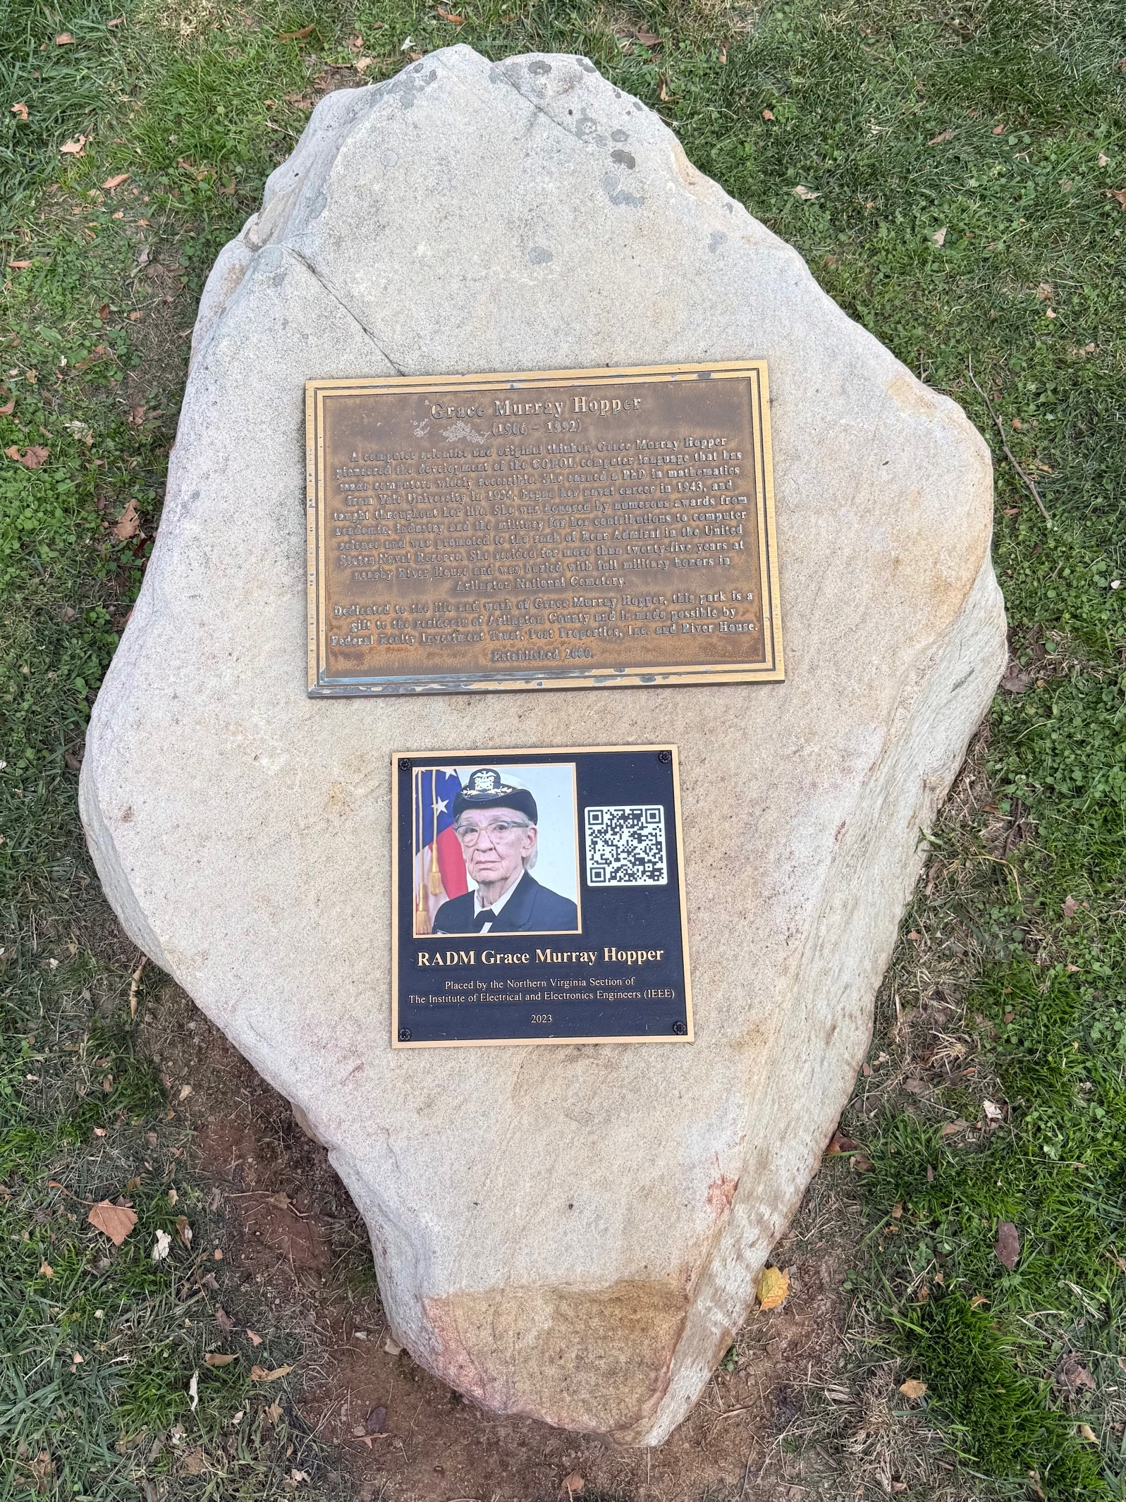
Coincidentally…
Jen lives across from where Admiral Grace Murray Hopper lived.

Slide 6



Definitions
Accessibility
Accessibility means that products and services are designed and developed so people with disabilities can use them. More specifically, they can perceive, understand, navigate, interact with, and contribute to the world.
Adapted from https://www.w3.org/WAI/fundamentals/accessibility-intro/#what, Icon from The Noun Project.
Chatbot
Chatbots are applications in which human customers converse with an automated, nonhuman service rep. Chatbots can be delivered through a variety of modalities: text message, chat platform such as Slack or Facebook Messenger, or embedded in a website.
Definition from the MITRE Chatbot Accessibility Playbook
AI Agent
AI agents are software systems or programs can autonomously pursue goals and complete tasks on behalf of users or other systems.
Adapted from Google Cloud and IBM: https://cloud.google.com/discover/what-are-ai-agents and https://www.ibm.com/think/topics/ai-agents

Slide 7
What is Online Accessibility?
Online accessibility means providing people with disabilities “access to information comparable to access available to others.”
Why does it matter?
~25% of Americans and an estimated 16% of people in the world live with disabilities.
Sources
IT Accessibility/Section 508 (2021). www.gsa.gov/section508
Disability Impacts All of Us (2021). https://www.cdc.gov/ncbddd/disabilityandhealth/infographic-disability-impacts-all.html
Disability (2023), World Health Organization. https://www.who.int/health-topics/disability
Notes:
To this end, the World Wide Web Consortium (W3C) publishes Web Content Accessibility Guidelines (WCAG, currently version 2.2), which provide requirements and associated success criteria for web designers, developers, and testers to evaluate the accessibility of their applications.
WCAG specifically addresses “blindness and low vision, deafness and hearing loss, limited movement, speech disabilities, photosensitivity, and combinations of these, and some accommodation for learning disabilities and cognitive limitations.”
WCAG’s guidelines are categorized within the principles of Perceivability, Operability, Understandability, or Robustness (represented by the mnemonic POUR)[See an overview of WCAG guidelines at https://www.w3.org/WAI/standards-guidelines/wcag/glance/.]. Digital.gov and Webaim.org also provide useful introduction and resources on accessibility.

Slide 8



ELI5 (Explain Like I’m 5-years-old)
ELI5 is a simple, easy-to-understand explanation of a complicated topic, using analogies and simple language, as if explaining it to a five-year-old.
While not literally for young children, it encourages simplifying complex concepts for a broad audience with limited prior knowledge.

Slide 9
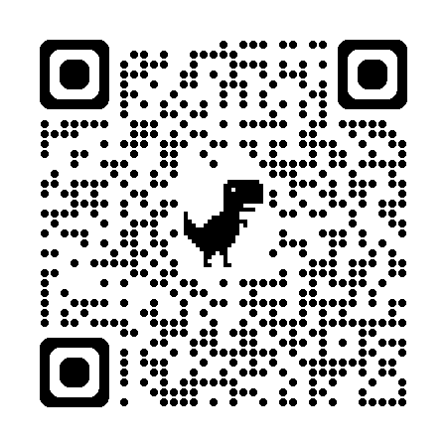
The MITRE Chatbot Accessibility Playbook
Released May 27, 2022. A MITRE team has created a playbook with guidance on designing and developing accessible chatbots, addressing federal requirements that people with disabilities have access to services and information comparable to those without disabilities.
https://mitre.github.io/chatbot-accessibility-playbook/

Slide 10



Context
Government services are shifting to web-based platforms to benefit from the cost and time saving advantages inherent in these technologies, while increasing the relevance and level of service provided.
Interactive technologies like chatbots can provide high-level targeted services for common questions, simple requests, and preliminary information for complex requests without human supervision — saving time and money, while providing value to the user.
As the U.S. government’s online services are meant for a broad cross-section of citizens, they must provide satisfactory experiences to all users, including those with disabilities.

Slide 11
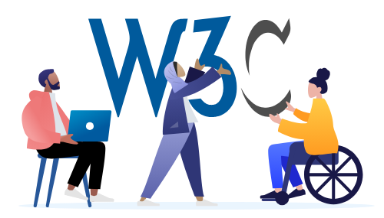
Current Accessibility Practice
The World Wide Web Consortium (W3C) provides the Web Content Accessibility Guidelines (WCAG), accessibility standards for websites, which entities like the United States government reference in their accessibility requirements.
In 2022, accessibility standards did not offer specific guidance for developing accessible chatbot interfaces. This gap meant that development teams were likely to produce chatbot content and interfaces that are inaccessible or needlessly difficult to users with disabilities.

Slide 12
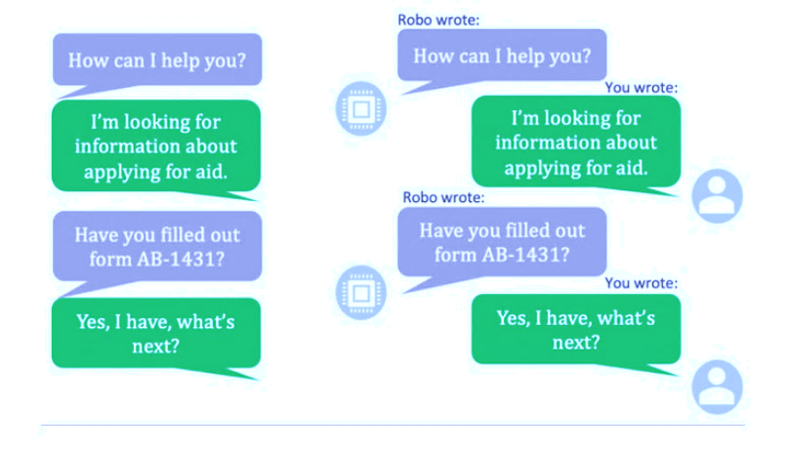
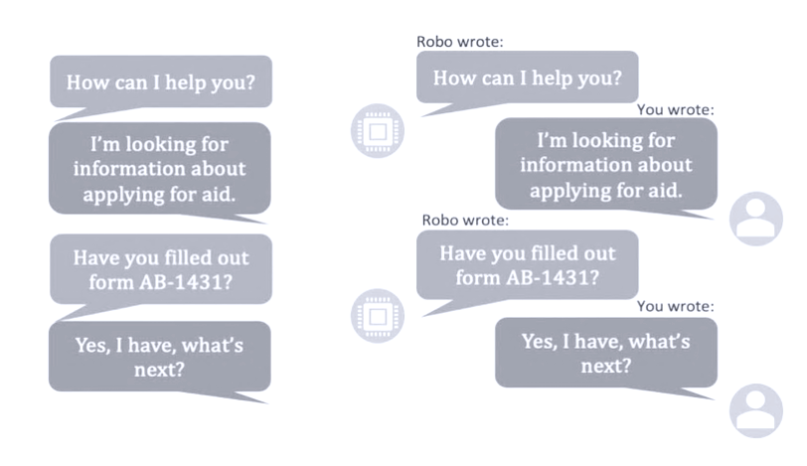
WCAG Guidelines
In practice, make one side of the conversation black on white – especially the chatbot responses, while the other is light on dark, so it’s very clear. Using different fonts can also help.
Although developed for general internet content, WCAG guidelines can and should be applied to chatbots whenever possible.
For instance, Success Criterion 1.4.1 “Use of Color” requires color not be used as the only visual means of conveying information, indicating action, prompting a response, or distinguishing a visual element.
When applied to chatbots, this means that the color of text or text background should not be the only identifier of a message’s author.
Labeling messages (“You wrote:”), horizontal alignment of messages, and author avatars can all help to visually differentiate between messages from different authors.
In color above,
greyscale below

Slide 13
Accessible Chatbot Outcomes
By ensuring all users have access to digital services, government agencies can reduce operating costs, reach a broader userbase, improve public perception, and avoid accessibility-related litigation.
The public gains access to products that meet a wider array of user needs, improving experience for all and establishing the importance of accessibility as well as usability.
As this playbook covers dynamic, interactive web applications, many of the recommendations apply to digital elements with similar dynamic characteristics, such as wizards.

Slide 14
Key Points
A chatbot must be well-integrated into the surrounding website or app and provide interface solutions for a range of input and output devices and techniques.
A chatbot’s interface, content, and dialogue should be simple and straightforward.
The development team should follow existing accessibility standards wherever they apply and include diverse users throughout the design process, as there is no “one size fits all” solution to accessibility.
This playbook synthesizes academic, government, and industry sources to recommend “plays,” which are targeted interventions and activities that a chatbot development team can use to achieve these ends and maximize the accessibility of a chatbot.

Slide 15
Solution: The Chatbot Accessibility Playbook
We compiled the latest research into the Accessible Chatbot Playbook—a set of recommendations to help you design and assess your bot’s accessibility.
Five Strategic “Plays” We organized across the entire development lifecycle, from initial design to final evaluation. It’s not a checklist; it’s a development roadmap.
Actionable Activities These aren’t abstract rules—they are steps grounded in user research and design principles to help you start the right conversations.
User-Centered Design The goal of these activities is to directly elicit user needs to build a better, more inclusive product.
No single step guarantees accessibility. It’s a team effort!

Slide 16
How to use the Playbook

Slide 17
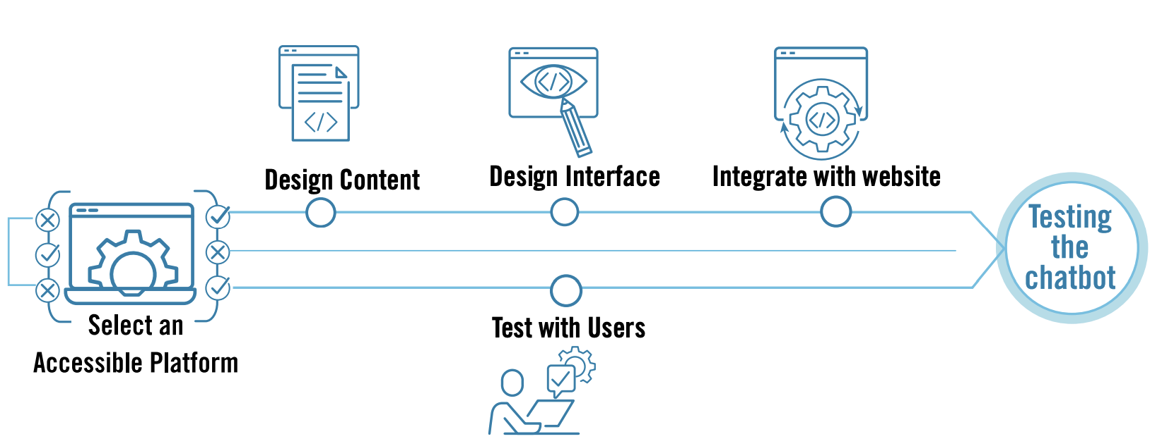
Plays
The primary accessibility goals are summarized at the beginning of each play.
As with any software development, the process for designing and developing a chatbot varies case by case, but there are some key plays in every development effort.
The plays include selecting a chatbot platform, designing the chatbot content, designing the chatbot interface, integrating the chatbot into the host website or application, and testing the chatbot.

Slide 18

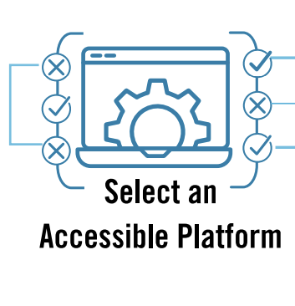
Play 1. Selecting the chatbot platform
Selecting the chatbot platform may include some back-end (e.g., language processing) components and some front-end (e.g., look and feel) components. Some platforms offer more customization than others.
It is important to consider accessibility and flexibility during this play because a more accessible chatbot platform will save development and testing time later, and a more flexible platform will accommodate a broader range of accessibility customizations.

Slide 19
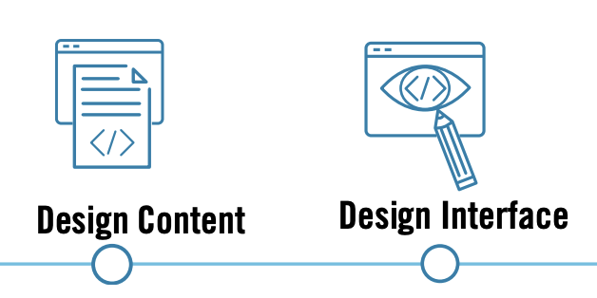
Play 2. Design the content and the interface
After selecting the chatbot platform, the chatbot development team needs to design the content and the interface.
The content is comprised of the conversation messages and the chatbot’s ability to understand the user’s messages.
The interface includes the chatbot window appearance and the accessibility of interactive functions like buttons.
Both plays offer many opportunities to make choices for accessible (or inaccessible) design.

Slide 20
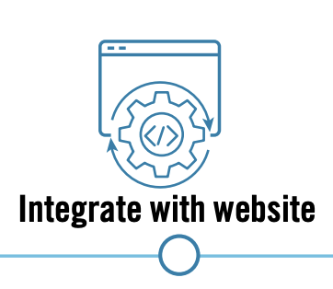
Play 3. Integrate into host website or smart phone app
The chatbot will most likely be integrated into a host website or smart phone application, which can present unique accessibility challenges.
While the website and the chatbot window may both be very accessible, navigation to and from the chatbot window and notifications for new chatbot messages may hinder people with disabilities who try to use the chatbot.

Slide 21
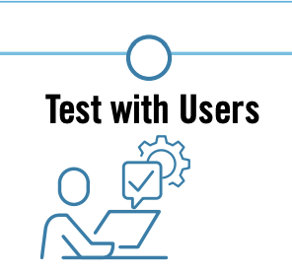
Play 4. Test the chatbot
Throughout the process, it is critical the team test the chatbot directly with target users.
“Target users” means the types of users the chatbot is meant to serve, typically defined by goals. Except for very specific circumstances, your target users shouldn’t be defined by disabilities.
For example, a chatbot that answers routine questions about Social Security benefits may be used more often by people near or above the national retirement age; the target users may be adults over 50 years old.
These users have an increased incidence of vision or hearing loss and cognitive impairment than the general public.
Therefore, it’s important to test this chatbot with older users that have multiple disabilities as well as older users without disabilities.

Slide 22
More Plays
3.2 Chatbot Development Team
3.2.1 Product Owner
3.2.2 Designer
3.2.3 Developer
3.2.4 Tester
3.3 Diverse Abilities
3.4 Design Process and Activities
3.4.1 Gather and Organize
3.4.2 Design and Implement
3.4.3 Test & Evaluate
3.5 How to Select a Subset of Activities

Slide 23
What about AI Agents?
Note: the illustrations in this section were generated using Google Gemini, and they are cited in the Notes for each slide.

Slide 24
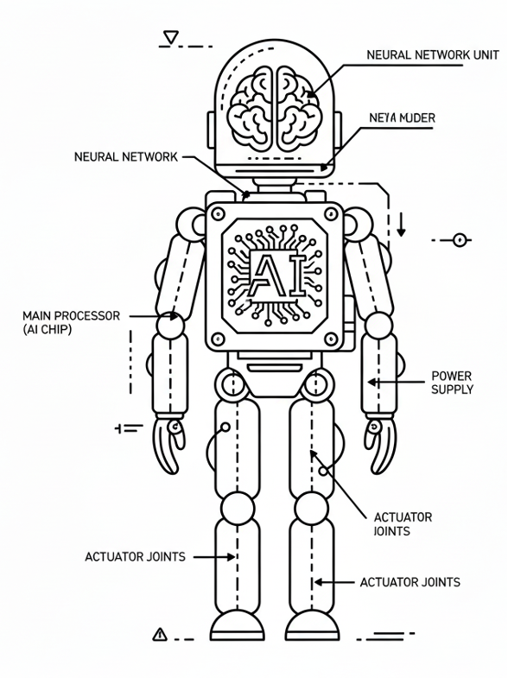
First, what is an AI agent?
“AI agents are advanced AI systems designed to autonomously reason, plan, and execute complex tasks based on high-level goals.”
We can use them to automate repetitive work, retrieve information, make decisions, and take actions by connecting to myriad software and devices, to improve productivity, scale teams, and enable innovation in organizations.
Source: https://www.nvidia.com/en-us/glossary/ai-agents/
Notes:
Google. (2025, October 15). Prompt “Provide a very simple line drawing of an AI agent in the style of a schematic illustration.” Gemini, 2.5 Flash. https://g.co/gemini/share/ef7259dbc112
Definition of an AI agent: an autonomous system that performs tasks or makes decisions on behalf of users, such as browsing the web or controlling a computer, without needing constant human input, distinguishing it from chatbots that require prompts to act. [Source: https://www.uxtigers.com/post/ai-agents]

Slide 25

ELI5: What is an AI Agent?
A magical, super-smart helper that lives inside a computer.
Notes:
Google. (2025, October 15). Prompt “draw an AI agent as a fantasy southeast asian fairy that lives inside a computer in the style of Audrey Kawasaki. The fairy should look like a native Polynesian person, and should be gender-neutral and a little over-weight.” Gemini, 2.5 Flash. https://g.co/gemini/share/1d8f89869ed6 Note: I added that the fairy should be a little over-weight and gender-neutral because anything else came back too sexualized. Even this is a little bit so.

Slide 26
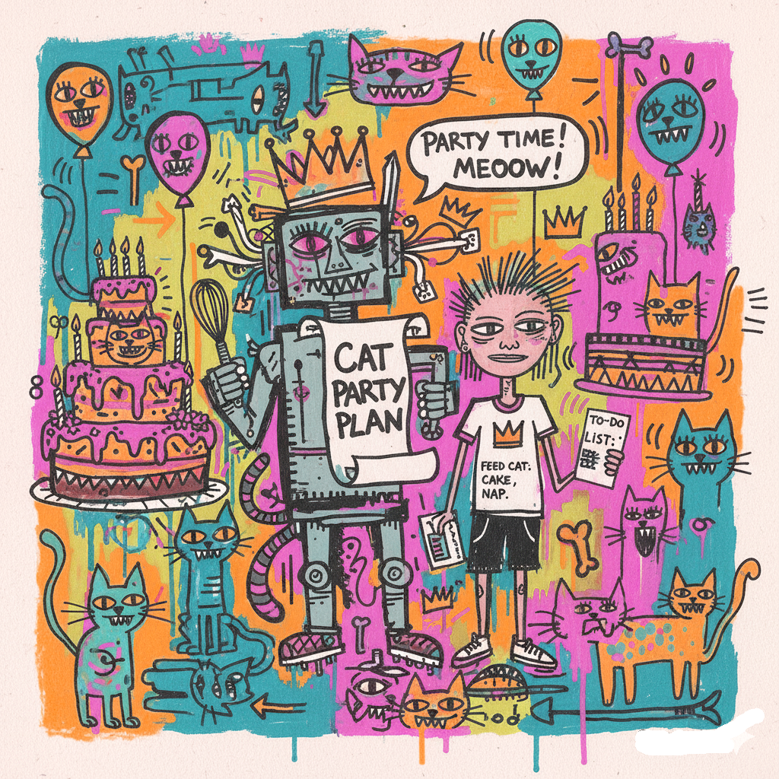
Here is how your helper works
You tell it what you want. You can ask it to do something big, like “Plan a cat party for me!”
It plans all by itself. Your magical helper figures out all the little steps, like, “First, I need to find some cat ideas, then find a cat cake recipe, and then send a cat invite.”
It uses tools to do the work. To find ideas, it might look on the internet. To send invites, it might use your mom or dad’s email.
It remembers things you told it. So, if you already said you like chocolate cake, it remembers and plans for one.
Instead of a person having to give it every little instruction, the AI agent thinks and plans to get the job done all by itself.
Notes:
Google. (2025, October 15). Prompt “Give me a cartoon drawing showing an agentic AI as a robot or a fairy completing a task for an ambiguous race and gender-neutral person that wants to organize a cat-themed birthday party in the style of basquiat.” Gemini, 2.5 Flash. https://g.co/gemini/share/1866cff48333

Slide 27
How do we design AI agents to be accessible?
Manage expectations. Be transparent about what the agent can and can’t do, and be clear that it is an agent, not a person. Don’t exaggerate. Keep branding simple.
Match and respect norms. Interactions should be polite, in context, and prompt. Don’t interrupt the user, unless it is urgent. “Use tone and language that fit the user’s cultural context.”
Ensure content is ready for agent use. Within your control, ensure the content provides useful, clear detail.
Be transparent and clear. Explain decisions made and provide data provenance.
Keep user in control. Maintain user input to correct, opt-out, review, undo, and confirm any actions.
Be helpful when errors happen. Design for error states, provide recovery options, and never abandon the user.
Invite user to improve agent. Include feedback opportunities in design.
Learn over time, openly. Inform user that the agent learns from user behavior over time.
Notes:
Sources
From Jakob Nielsen, https://www.uxtigers.com/post/ai-agents
From Léonié Watson, https://www.linkedin.com/pulse/accessibility-agentic-web-l%25C3%25A9onie-watson-mxuke/

Slide 28
How do we develop accessible AI agents?
Structure HTML semantically. Clear structure helps the agent understand, minimizes errors. Use HTML5 elements (<header>, <nav>, <main>, and <footer>) instead of generic <div> tags. Use proper heading order. Minimize use of <div> and <span> tags.
Use structured data. Use Schema.org tags so agent can understand what your content is about. Provide rich meta descriptions and informative alt text for images. Use consistent formats for dates (YYYY-MM-DD), prices ($12.50), and units. Test with schema.org’s validator.
Optimize content readability. Ensure your content is well-structured, with clear headings and unambiguous formatting so the agent can easily understand it.
Build reliable API layers. Agents use APIs to fetch structured data instead of scraping messy HTML, so ensure API is infallible.
Streamline navigation. Create clear navigation structures so AI and accessibility tools can interpret content hierarchy.
Optimize images and videos, provide alt text and descriptions. Use descriptive filenames and alt text for images and graphs. Provide transcripts and structured annotations/metadata for videos.
Use best practice and web standards. Incorporate current web standards and best practices to ensure services stay compatible with evolving AI interactions. Monitor with analytics tools, maintain backwards compatibility, document technical changes, and maintain consistent data structure.

Slide 29
Summary
MITRE’s Chatbot Accessibility Playbook provides validated guidance to select, design, develop/integrate, and test chatbot implementations
As AI agents take on more powerful, autonomous roles, great care must be taken to ensure their development is accessible, ethical, and built for the future. Ignoring these factors can lead to immediate failure, long-term societal risks, and cementing inequities.
Technology is evolving so fast that designers and developers must create with an eye toward long-term compatibility, resilience, and ethical governance.

Slide 30
Thank you! ツ

Slide 31

Follow Us
linkedin.com/in/amna-abbas-hfac/
linkedin.com/in/stricklandjen
MITRE Chatbot Accessibility Playbook

